Slide 1
Starter- how does the body lift this weight up?

Slide 2
Muscles and joints

Slide 3
Successful outcomes
Explain how muscles and joints bring about the movement of bones
Identify the main bones in the arms
Explain what antagonistic muscles are and how they result in an arm bending or straightening

Slide 4
Structure of the main bones and muscles of the arm

Slide 5
Key facts- what happens when for the arm to bend
Biceps and triceps muscles are antagonistic muscles. When the biceps contracts the triceps relaxes.
When the biceps contracts, the tendon (join muscle to bone) attached to the radius does not stretch and so pulls the radius up (arm bends).
http://www.bbc.co.uk/science/humanbody/body/factfiles/workinpairs/triceps_animation.shtml

Slide 6
What happens when an arm tried to lift a load

Slide 7
Straightening of the arm
Triceps muscles contracts and the bicep relaxes
The triceps tendon attached to the ulna, pulls on the ulna and the ulna straightens.

Slide 8
task
Stick your paper template of the arm joint on to card and cut them out
Make holes in the correct places to pull string through (string represents the muscles).
Make the model arm joint bend and straighten using the string in antagonistic pairs.

Slide 9
Arm bending like a lever
The bending and straightening of an arm is works just like a lever.
The elbow is the pivot (fulcrum), the load is what is placed on the hand for lifting, and the muscles produce the effort by contracting with a force which is larger than the load.

Slide 10
Joints
Joints are where 2 bones meet
3 types
Fixed
Hinge
Ball and socket

Slide 11
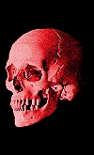
Fixed joint
Fixed joints are found in the skull, The skull is made up of plates of bone that are fused together.
At birth, babies have a cartilage patch on top of the skull, so that the bones of the head can be squeezed as the baby passes through the birth canal.

Slide 12
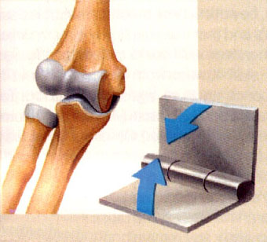
Hinge joints
At your elbow and knee is a hinge joint, and this movement in one plane.
You can bend and straighten your arms and legs due to these joints.
These joints can lock into place if you are lifting a heavy weight.

Slide 13
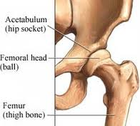
Ball and socket joint
These joints are found in the shoulder and hip, allow movement in many directions and so you can rotate your limbs.

Slide 14
Synovial joints
Joints that are freely moveable are also called synovial joints (hinge and ball and socket).
These joints are adapted to allow friction-free movement.

Slide 15
Synovial joint- adaptations
End of the moving bones (articulating), and covered in slippery cartilage (reduces friction).
Whole joint is enclosed in a capsule.
There is a lining inside the capsule called a synovial membrane. This secretes synovial fluid which lubricates the joint.

Slide 16
Ligament- Key fact
Hold the bones of the synovial joint together.
They can stretch and allow movement

Slide 17
Plenary
On the work sheet label the main bones and muscles on the elbow joint.
On the worksheet, label the synovial joint.

Slide 18
answers

Slide 19
answers

Slide 20
More questions
What is the difference between a tendon and a ligament?
Name the 3 types of joint in the body, explain where you would find them in the body, and describe any movement they allow.
Explain why the arm straightens and bends like a lever.
Describe how a synovial joint is adapted to allow friction-free movement

